Slide 1

Fly on The Data Center

Slide 2
WHO FLY? WHAT FLY? HOW FLY?
SIX FAQ.S
Internet
Medium
Data
Cables
Hardware
Weather
Satellite Communication
Store Data
Running Data
Submarine Cables
Land Lines Cables
Data fly is a medium of way to communication system, which is connection of two or more system connected together to share the information and resources.

Slide 3


Land Lines Cables Data Transmission Systems Tropology
Network Topology
Local Area Network
Metropolitan Area Network
Wide Area Network
Bus
Star
Mesh
Ring
Line
Tree
Star +
Ring
Land Lines Data Transmission will be way of connection of Several Types of Nodes with using of several Types of Network tropology.

Slide 4
Algorithm for Topological Sort
Now we will used the pseudocode Algorithm, Now doing The real time SxS
Data fly! Transmission data here find out the nodes and incoming edges and add it for sorted list and delete, store the edges in an indegree arrays and we need to remove the outgoing edges from node. So hence the search node will be indegree = 0 here if we not reach to find the node with indegree that will be 0
So the cycle will be
sorted <-- Empty list initially, of the topologically sorted elements
zero_incoming <-- set of nodes with indegree = 0
So the variable v in the number of vertices
vector<int> sorted;
vector<int> indegrees(v, 0);
queue<int> zero_incoming;
Now process the nodes into Top to Zero _incoming.
while (!zero_incoming.empty()){
int node = zero_incoming.front();
zero_incoming.pop();
sorted.push_back(node);
}

Slide 5
vector<int> topological_sort(vector<list<int>> adj_list){
int v = adj_list.size();
vector<int> sorted;
vector<int> indegrees(v, 0);
queue<int> zero_incoming;
for (int node = 0; node < v; node++){
list<int>::iterator itr;
for (itr = adj_list.begin(); itr != adj_list.end(); itr++){
indegrees[*itr]++;
}
}
int visited_nodes = 0;
while (!zero_incoming.empty()){
int node = zero_incoming.front();
zero_incoming.pop();
sorted.push_back(node);
list<int>::iterator itr;
for (itr = adj_list[node].begin(); itr != adj_list[node].end(); itr++){
if (--indegrees[*itr] == 0)
zero_incoming.push(*itr);
visited_nodes++;
}
}
if (visited_nodes != v)
throw "Graph contains a cycle";
else
return sorted;
}

Slide 6
Data Transmission System Java Base
public static int[] topological_sort(int[][] adj_list){
int v = adj_list.length;
int sorted[] = new int[];
int indegrees = new int[v];
Queue<Integer> zero_incoming = new LinkedList<Integer>();
for (int i = 0; i < v; i++){
ArrayList<Integer> temp = (ArrayList<Integer>)adj_list[i];
for (int node : temp)
indegrees[node]++;
}
for (int node = 0; node < v; node++){
if (indegrees[node] == 0)
zero_incoming.push(node);
}
int visited_nodes = 0;
while (!zero_incoming.empty()){
int node = zero_incoming.poll();
sorted.add(node);
for (int u: adj_list[node]){
if (--indegrees[u] == 0)
zero_incoming.add(u);
}
visited_nodes++;
}
if (visited_nodes != v)
throw new Exception("Graph contains a cycle!");
else
return sorted;
}

Slide 7

Data transmission propose rate control for transport layer scheduling and the network layer
routing and the mac layer, power control layer and algorithm of the physical layer. Suppose Two nodes communication based algorithm theory. Social opportunistic network System design, which can be expressed of $G_{c}=\{E_{c} V_{c}\left(t\right)\}$ So it can be expressed into $G_{s}=\left\{V_{s}E_{s}\left(t\right)\right\}$ Network communication ntworks are time-varying dynamic ntworks that are affected by the interaction. measure the connection strength w between nodes,
$$SPM=\frac{\int_{t=0}^{T}{f\left(t\right)dt}}{T}, W_{ij}=\frac{1}{{SPM}_{ij} } −−−−−−−−−−−−−−−−−−−−−−−−− 1$$
statistical window T on the calculation of social pressure is normalized, which is shown as follows:
$${SPM}_{ij}=\frac{{SPM}_{ij}}{({SPM}_{ij)max}}=\frac{2\int_{t=0}^{T}{f\left(t\right)dt}}{T^{2}},0≤{SPM}_{IJ}^{,}≤ij −−−−−−−−−−−−−−−−−−−−−−−−−−−−−− 2$$
So the strongest connection between the two nodes: Range 0-1 and $W_{ij}=1$ so the following equation is……
$$W_{ij}=\frac{e^{b(1−SPM_{ij})}−1}{e^{b−1}},0≤W_{ij}≤1 −−−−−−−−−−−−−−−−−−−−−−−−−−−−−−−−−−−−− 3$$
Where b is the positive coefficient.
Data Transmission Algorithm

Slide 8
Input: Ni
, Nj
Output: forward message List
Begin
If Ni and Nj meet
/* the strength of the connection wi
is inversely proportional to the social pressure between the above
nodes */
f(t) = 0, SPM = 0, wij = 1;
End if
If (wij ≥ wth)
forward messages in single copy mode;
Else
binary-spray focus mode for multi copy distribution transmission;
End else if
/* If the node i has only one neighbor node j */
If (Ni
.hasOnlyOneNeighbor(j))
Pij(m) = Ni
.leaveForOtherNode(Nj
);
Else
/* If the node i has multi neighbor nodes */
For (node Nj
in Ni
.neighBorList)
Pi
(m) + = Ni
.leaveForOtherNode(Nj
)*Nj
.weightInNeighboList(Ni
);
End for
End else
/* According to Formulas (9)–(11), all of these are calculated. */
Set Ci
, Fi
, ps−i
(m);
When Ni and Nj meet
Algorithm Message Routing Strategy
/* sorting the ps−i
(m) values of n messages to be transmitted in node i cache from large to small */
List = {m1, m2, . . . , mk, . . . , mn};
k = [n· Fj] //the number of messages to be transmitted;
um = ps−i
(m) · hopm //utility values for messages in the list;
Update List
/* According to Formula (12) */
(
maxT =
Pz
k=1
ukχk
,
s.t.
Pz
k=1
ukχk ≤ θi
, χk ∈ {0, 1}
If (χk = 0)
Put in forwarding queue;
Else if (χk = 1)
Do not put in forwarding queue;
Output List;
End

Slide 9
Data Fly Theory
What is the data Transmission: Data Transmission is a schema, After we input the information in keyboard each type of the parameters encoded by electronics symbol which we called code pattern of the interchange of information. Like if we use the 7 or 8 bits size then the user of 7 bits represent that 128 different elements and when we used the 8 bits of the size, the 8 bits represents that 256 elements. Following this procedure receiver the decodes every receiver binary pattern into the characters. Binary code Decimal which we called the (ASCII) codes. Hence we got now the unique types of the data transmission.
Data Transmission
Parallel
Serial
Synchronous
Asynchronous
It is the super speed transmitting data as multiple bits with a single clock pulse, but it is very costly process.
Parallel transfer is that connecting each sub-unit and data exchange.
Sender
1
Parallel Data Fly
Receiver
1
0
0
1
1
0
0

Slide 10
Data transmission with two physical separate devices especially if the separation from few kilometers. This transmission bits called the serial transmitted serially one after the other serial. if we and we transmit 8 bit data 11001010 is to be sent from source. This conversion transmission convert parallel data into serial data at the sender side.
Serial Data Transmission
11001010
Sender
1
Parallel to Serial Convert
Serial To Parallel
Sender
1
001010
MSB
LSB
1 1 0 0 1 0 1 0
Single Communication Line
Serial transmission Good sites of the line reduces and cost by the factor of n as compared and the bad sites is this transmission is the slower then parallel transmission bits transmitted serially one after the other.

Slide 11
The Asynchronous Transmission send only one of the character at a time and the letter alphabet or number
control character i.e. it sends one of the data at a time. When this system work the both two system use the start and stop bit. that's also called the more secure. the stop bit indicates the end of data and the start bits indicates the appended to the end of the byte.
Asynchronous
Stop Bit
Data
Start Bit
1
1 1 0 1 0 1 1 0
0
Start and Stop Bit
This is the take idle time to data transmissions and different types of the data. This idle also know as the secure transmit. This transmission system the main fact is the a little bit slow and because of it’s transmit the data bit by bit serial wised. And It’s take time for also stop and start and size is a little bit big then other data packet.

Slide 12
Synchronous
Data continuously stream and from of signals which are accompanied by regular timing signals some the
external clocking mechanism meant to sure that both sender and recover synchronized with each other. Synchronous Transmission there is no gaps between character, Timing is supplied by modems, Special syn characters precede the data, and the syn character used to blocks chain transmission.
Sender
Receiver
10101010 11001111 01011110 00110011 10110011
Major of the focal point:
Data Gap: Synchronization transmission there is no data gap of each bits transmission and received in case the transmission receiver and sender do not synchronize in real time. The time of each data transmission character begins and ends with a start and stop symbol.
Operation coast: This system is much more coast effective rather then other transmission system, because this transmission is more slower then others.
Time interval: Synchronization data transmission time is constant.

Slide 13
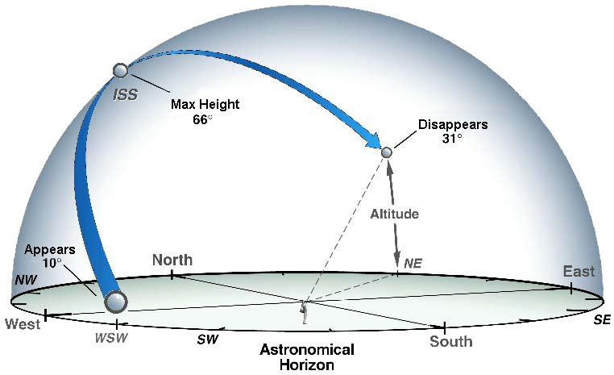
Fly on Data Center Sky Geo. Station
Satellite Sky Station
Quite Example: Fly on the Data center:
Wide Area Network: Important: The International Space Station orbits with an inclination of 51.6 degrees. This means that, as it orbits, the farthest north and south of the Equator it will ever go is 51.6 degrees latitude. If you live north or south of 51.6 degrees, the ISS will never go directly over your head- this includes places like Alaska. Spot The Station may not properly inform you of all visible space station passes in these locations
This picture Copy right from NASA

Slide 14
Thanks

